Slide 1
FIFA Player Position Prediction
Aruna Jithesh, Bashaarat Nawaz Mohammad, Chinmayi Karumuri, Gautam K
Notes:
"Good [morning/afternoon/evening], everyone. Today, we’ll present our project titled FIFA Player Position Prediction. I am Chinmayi, along with my teammates Bashaarat Nawaz Mohammad, Aruna, and Gautam. Let’s dive into how we leveraged machine learning and big data to optimize soccer player positioning."

Slide 2
Research Problem
Complexity of Soccer Dynamics: Modern soccer involves multifaceted strategies that depend on players being optimally positioned based on their attributes.
Overload of Player Data: The volume of data generated for each player (e.g., pace, passing, defending skills) makes manual analysis impractical.
Inconsistent Decision-Making: Different analysts may arrive at varying conclusions when evaluating player positions, leading to suboptimal team performance.
Demand for Real-Time Insights: In fast-paced soccer environments, coaches need immediate and accurate data-driven recommendations to adapt tactics during games.
Cost Implications: Inefficient player placement may result in financial losses, as high-value players are not utilized to their fullest potential.
Notes:
"Modern soccer is complex, requiring players to be optimally positioned based on their attributes. However, the overwhelming volume of player data makes manual analysis impractical. Inconsistent evaluations by analysts often lead to suboptimal decisions, negatively affecting team performance. Additionally, there is a growing demand for real-time insights to adapt strategies quickly during matches. This inefficiency can even result in financial losses if high-value players are underutilized. Our project addresses these challenges."

Slide 3
Objective
Optimize Player Positioning: Use machine learning to predict the most suitable role for each player based on their skills.
Enhance Decision-Making: Provide data-driven insights to replace subjective analyses by scouts and coaches.
Improve Team Performance: Align player attributes with tactical requirements to maximize team efficiency.
Adaptability: Develop a scalable solution that can integrate data from youth academies and across different leagues.
Innovate Player Development: Highlight areas for skill improvement to guide training and future player roles.
Notes:
"Our objective is to use machine learning to optimize player positioning based on their skills. By replacing subjective analyses with data-driven insights, we aim to enhance team performance, guide player development, and create a scalable solution that can adapt across leagues and academies."

Slide 4
Dataset
Source: Kaggle.
Dataset size: 5.64 GB.
110 total features describing player attributes, skills, and performance.
Data spans multiple leagues, seasons, and players.
Selected Features:
Using 19 key features for position prediction.
Features focus on:
Physical Attributes: Height, weight, age.
Technical Skills: Pace, shooting, passing, dribbling, defending.
Attacking Skills: Finishing, crossing, heading accuracy.
Power and Mentality: Stamina, interceptions, standing tackle.
Notes:
"Our dataset, sourced from Kaggle, is a 5.64 GB dataset with 110 features describing player attributes across multiple leagues and seasons. For this project, we focused on 19 key features, including physical attributes like height and weight, technical skills like passing and defending, and mental attributes like stamina and interceptions."

Slide 5
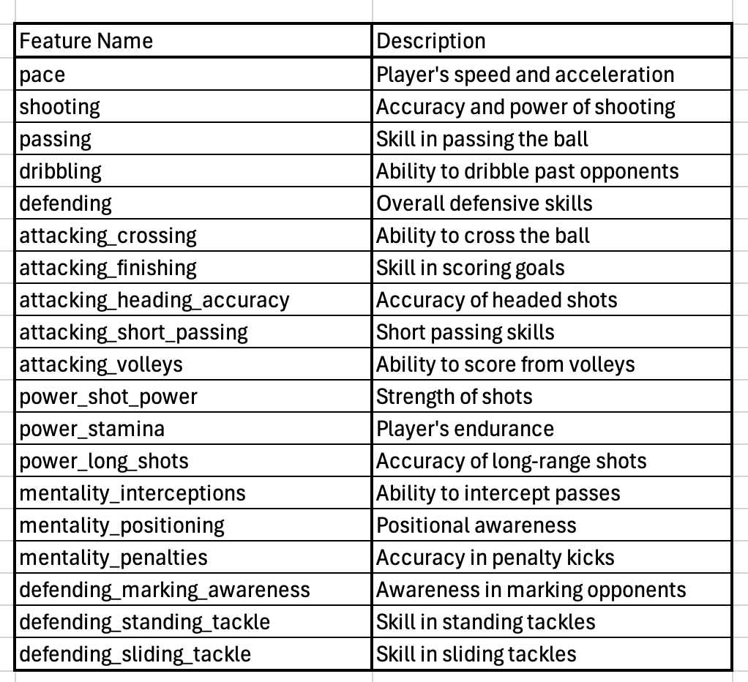
Dataset

Slide 6
Big Data Tools Utilized in FIFA Player Analysis
Primary Tool: PySpark was employed to efficiently process and analyze large-scale FIFA player datasets.
Focus Area: The analysis addressed the Volume aspect of big data, handling substantial amounts of information to extract meaningful insights.
Outcome: By leveraging PySpark, we effectively managed extensive data volumes, ensuring scalable and efficient processing essential for in-depth player performance analysis.
Notes:
"Given the dataset size, we utilized PySpark to handle the volume of data efficiently. PySpark allowed us to process and analyze large-scale FIFA player datasets, ensuring scalability and meaningful insights extraction."

Slide 7
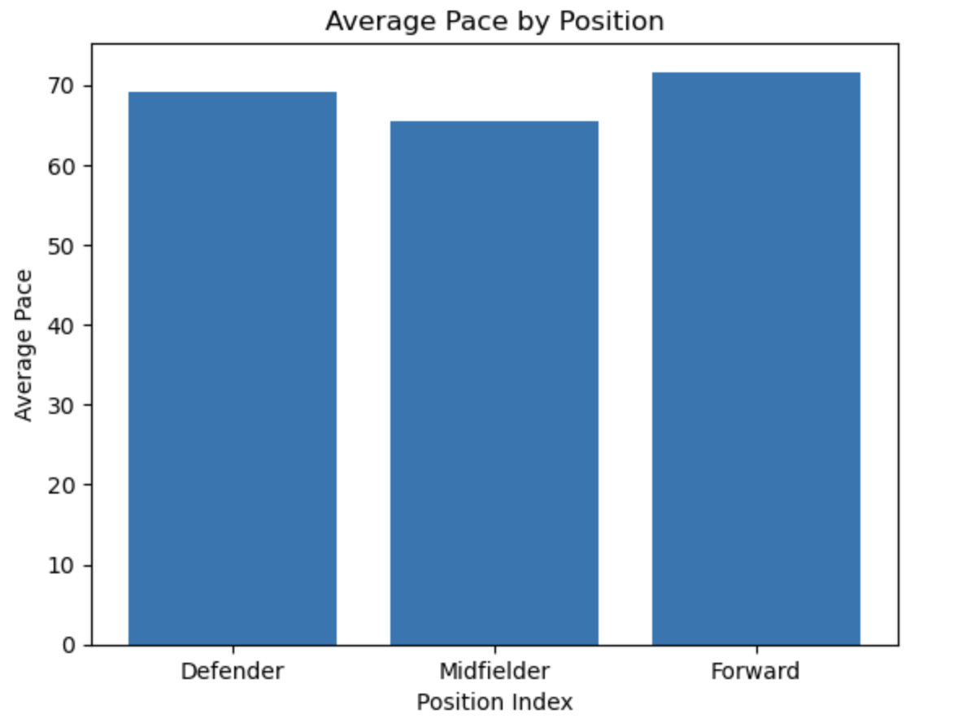
Exploratory Analysis:
Forwards have the highest average pace (~72), essential for scoring opportunities.
Defenders have moderate pace (~69), balancing speed with defensive duties.
Midfielders have the lowest pace (~65), reflecting their versatile linking role.
Notes:
The "Average Pace by Position" plot shows that forwards have the highest average pace (~72), crucial for creating scoring opportunities. Defenders exhibit a moderate pace (~69), balancing speed with defensive duties, while midfielders have the lowest pace (~65), reflecting their versatile role in linking defense and attack.

Slide 8
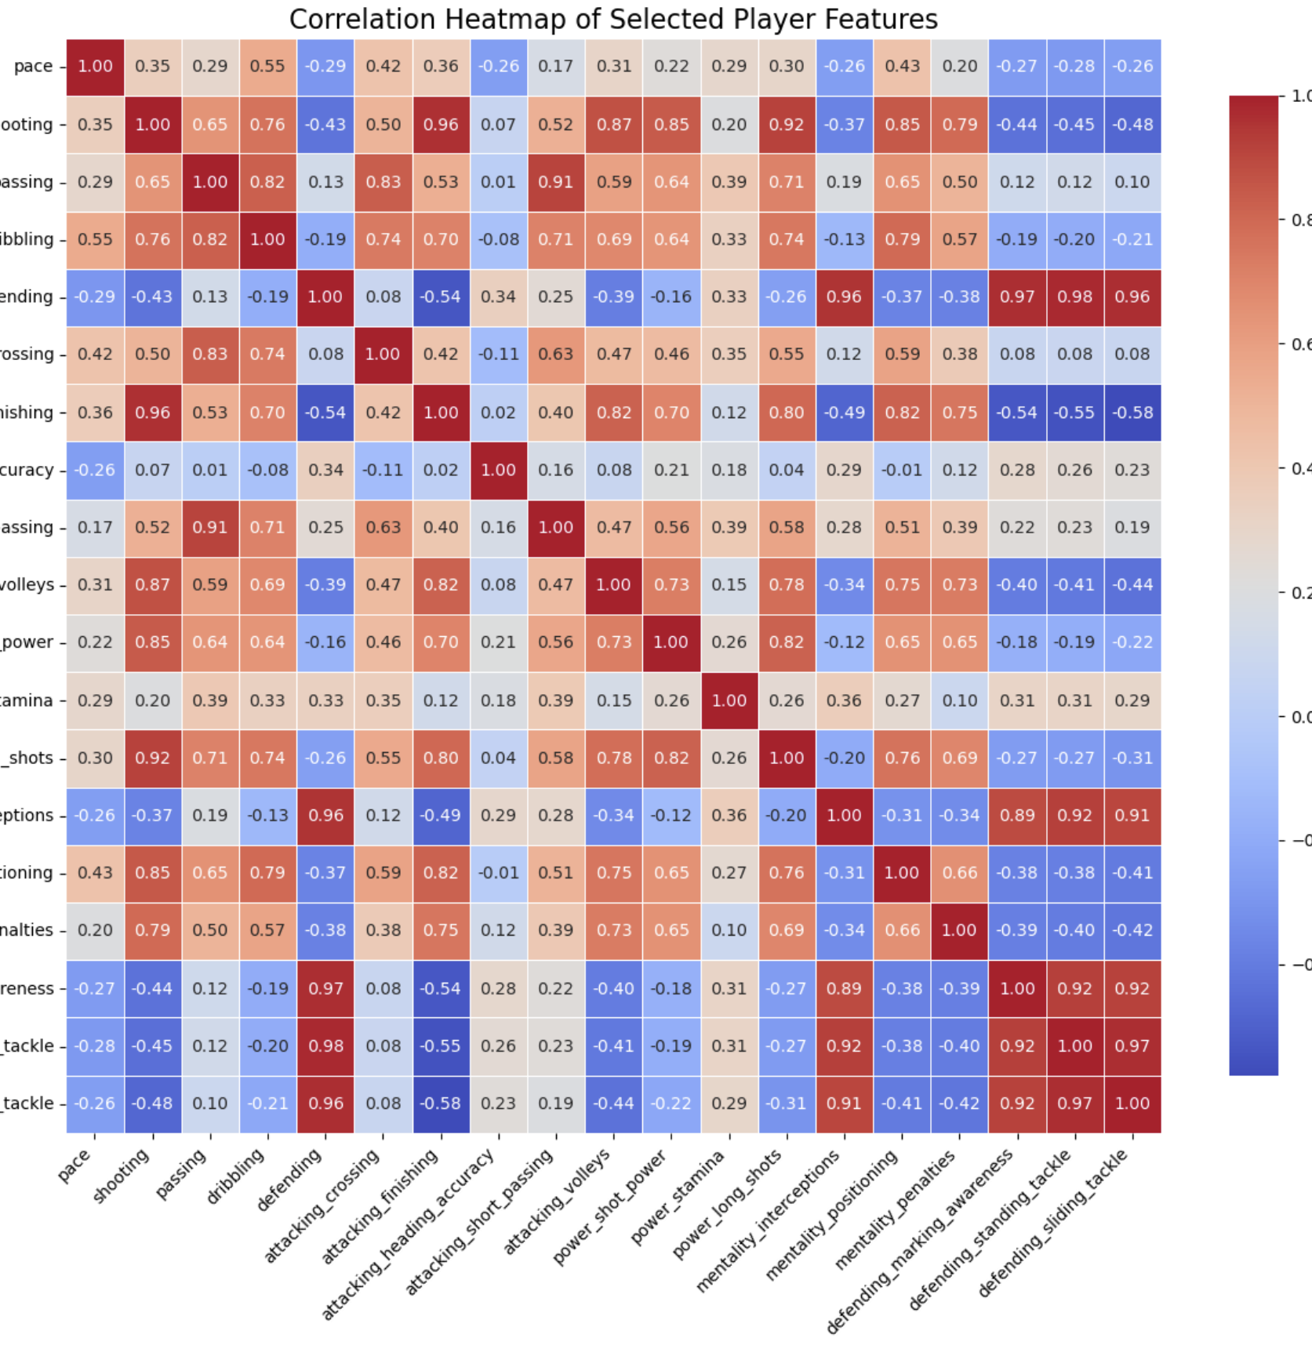
Heat Map
Shooting and passing have a strong positive correlation (0.91), linking offensive skills.
Defensive skills like marking and tackling are highly correlated (0.98), showing interdependence.
Weak pace-defending correlation highlights distinct skills for different player positions.
Notes:
The analysis reveals that shooting and passing have a strong positive correlation (0.91), emphasizing their link to offensive abilities. Similarly, defensive skills like marking and tackling exhibit a high correlation (0.98), showcasing their interdependence for defense-oriented players. Meanwhile, the weak correlation between pace and defending highlights the distinct skill sets required for different player roles.

Slide 9
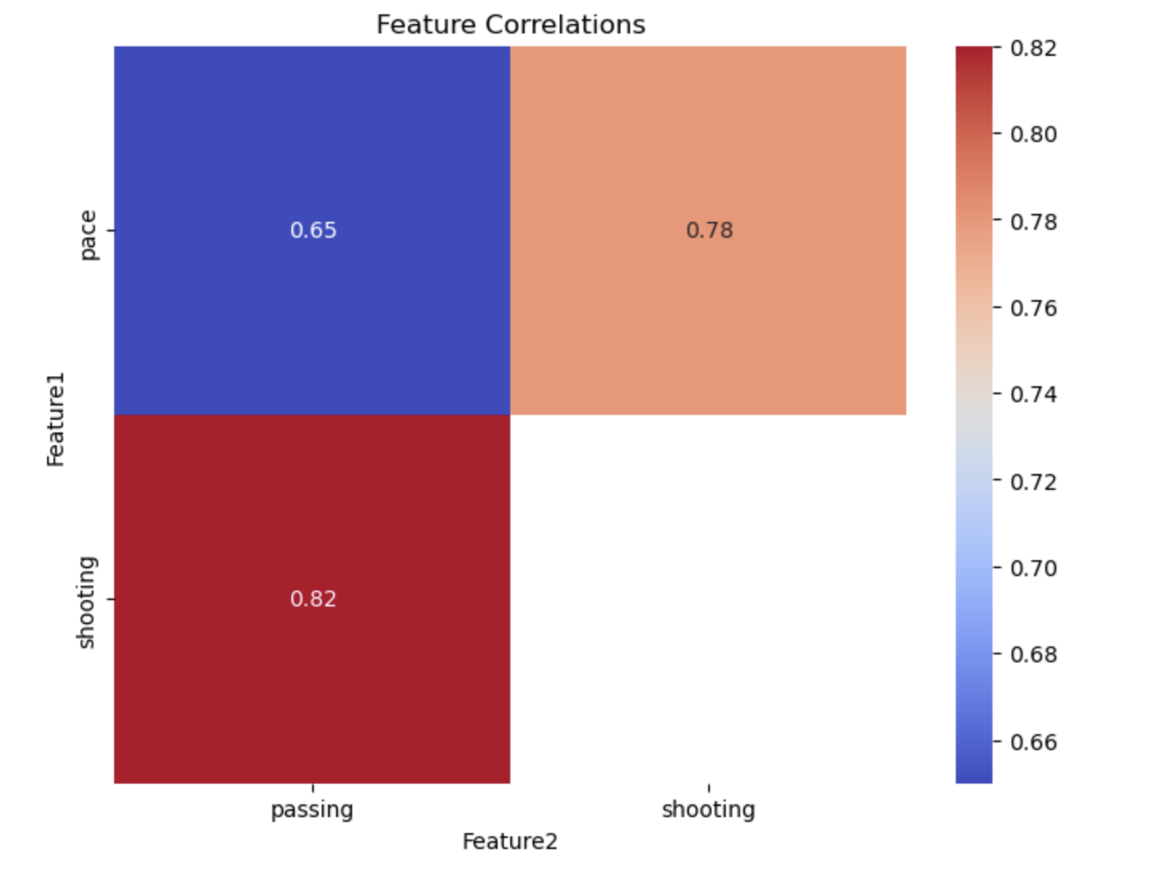
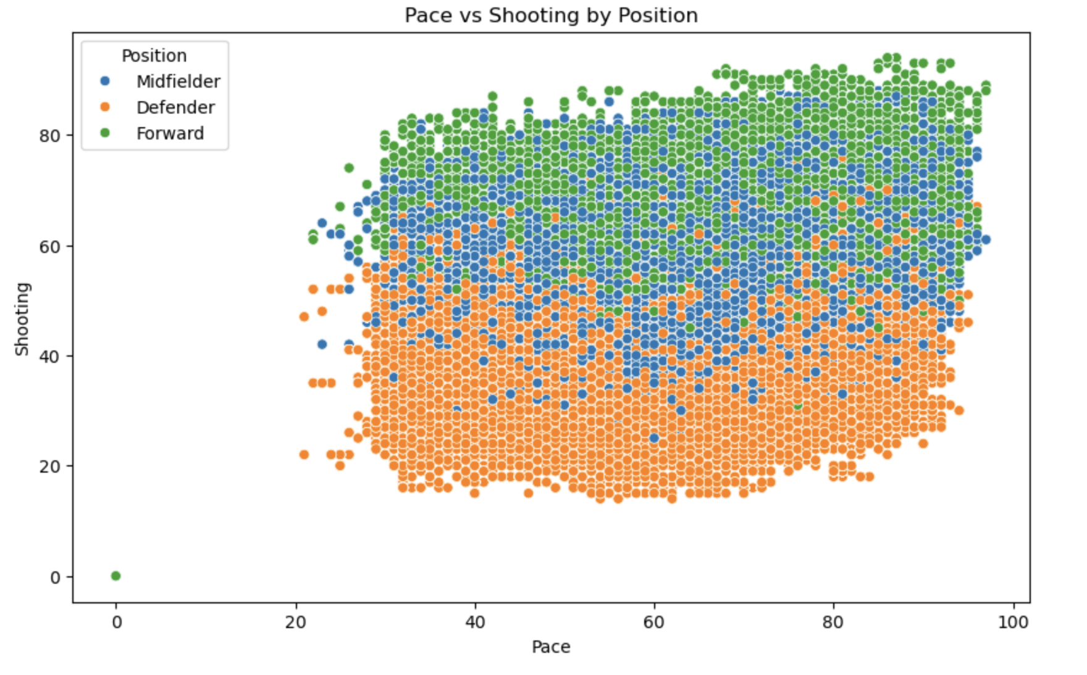
Pace vs Shooting
Strong shooting-passing correlation (0.82) highlights key offensive skills.
Moderate pace-shooting correlation (0.78) shows faster players often excel at shooting.
Lower pace-passing correlation (0.65) aligns with midfielders’ playmaking roles.
Forwards cluster in the upper-right, showing high pace and shooting for offense.
Defenders dominate the lower-left, with lower shooting but moderate pace for defense.
Midfielders spread in the middle, balancing pace and shooting for a linking role.
Notes:
The Feature Correlations Heatmap shows that shooting and passing are highly correlated (0.82), emphasizing their importance in offensive play. Pace and shooting have a moderate correlation (0.78), indicating faster players often excel in shooting. However, pace and passing show a lower correlation (0.65), highlighting midfielders' playmaking focus.
The Pace vs. Shooting Scatter Plot illustrates positional differences. Forwards exhibit high pace and shooting, clustering in the upper-right. Defenders dominate the lower-left with lower shooting and moderate pace, while midfielders are spread in the middle, balancing both attributes for their versatile role.

Slide 10
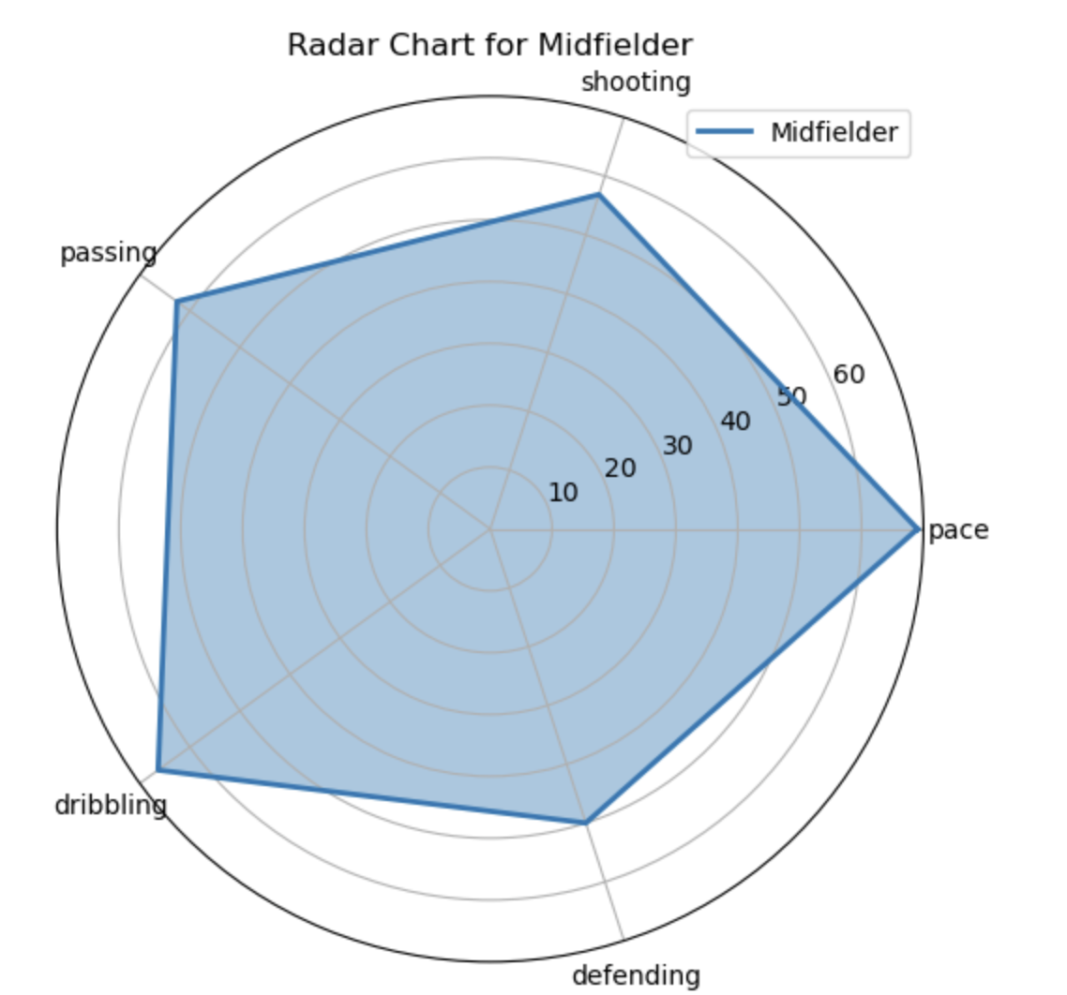
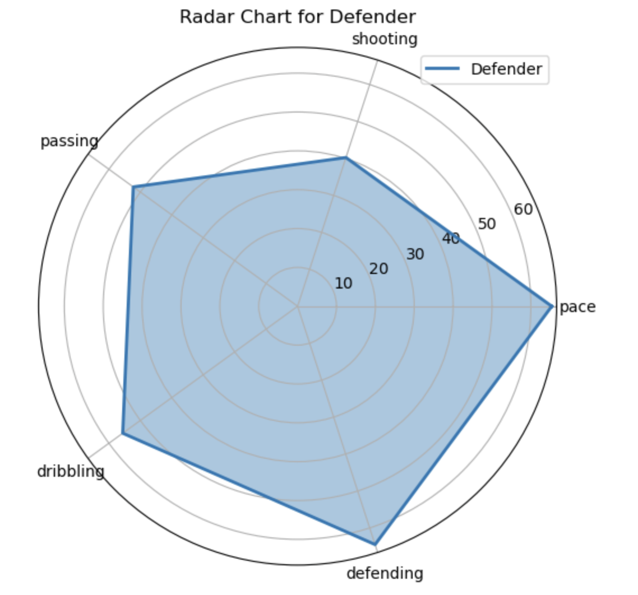
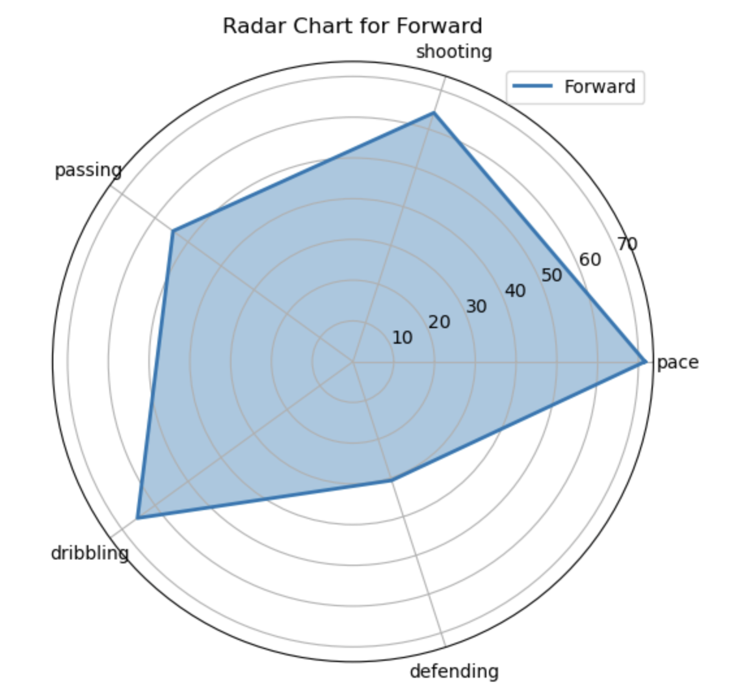
Radar Chart : Defenders, Forwards, Midfielders
Midfielders: Balanced in passing, dribbling, and defending, linking defense and attack..
Defenders: Excel in defending, with moderate passing and pace, focusing on goal protection and play initiation
Forwards: High shooting and pace, lower defending, emphasizing attacking and scoring.
Notes:
The Radar Chart: Defenders, Forwards, Midfielders shows:
Midfielders balance passing, dribbling, and defending, connecting defense and attack.
Defenders focus on strong defending, moderate passing, and pace for goal protection.
Forwards excel in shooting and pace, prioritizing attack and scoring.

Slide 11
Data Processing: Loading and Setup
Spark Setup: Created a Spark session, allocated 16GB memory for driver and executor, configured shuffle partitions to 200 for distributed processing.
Dataset Loading: Utilized PySpark to load male_players.csv with header=True and inferSchema=True.
Schema Validation: Ensured correct column types for player stats, attributes, and positions.
Optimization:Repartitioned data into 200 partitions for efficient operations.
Cached the DataFrame in memory and disk for transformation efficiency.
Checkpointing: Enabled checkpointing to manage intermediate data in complex pipelines.
Sample Operations: Validated data integrity with sample previews.
Resource Management: Released memory using unpersist after processing.
Notes:
"To process the dataset:
We created a Spark session and configured resources for distributed processing.
Loaded the dataset with schema validation to ensure correct data types.
Repartitioned the data and cached it for efficiency.
Enabled checkpointing to manage intermediate data for complex pipelines.
Unpersisted the dataset to release memory after processing."

Slide 12
Data Cleaning and Preprocessing
Irrelevant Column Removal:
Dropped columns like player_id, player_url, dob, player_face_url to focus on predictive attributes.
Excluded composite attributes like overall to prevent redundancy with individual skills.
Handling Missing Values:
Replaced null values in numerical features with 0 for attributes like pace, shooting, passing.
Removed rows with critical null values in primary features.
Goalkeeper Exclusion:
Dropped goalkeeping-specific attributes (e.g., goalkeeping_diving, goalkeeping_reflexes).
Filtered out players with primary_position as "GK" to focus on outfield positions.
Notes:
We cleaned the dataset by removing unnecessary columns like player_id, player_url, and dob, and excluded redundant attributes like overall. Missing values in numerical features, such as pace and shooting, were replaced with 0, and rows with critical missing data were removed. Goalkeeper-specific attributes were dropped, and players listed as 'GK' were excluded to focus on outfield positions. These steps ensured the data was ready for analysis.

Slide 13
Position Simplification and Feature Selection
Filter and Transform Position Data
Primary Position Extraction: Isolated the main role from the player_positions column, which contains comma-separated values, to focus on each player's primary position.
DataFrame Update: Added a new column, primary_position, with the extracted primary role and removed the original player_positions column to streamline the dataset.
Position Extraction:
Extracted primary position from multiple roles using split function (e.g., "RW, ST" → "RW").
Grouped positions into broader categories:
Defender: CB, RB, LB, RWB, LWB.
Midfielder: CM, CDM, CAM, RM, LM.
Forward: ST, CF, LW, RW, RF, LF.
Feature Selection:
Reduced features from 110 to 19 key features relevant to position prediction.
Focused on physical attributes, technical skills, and attacking/defensive capabilities (e.g., pace, passing, defending).
Notes:
"We processed and transformed position data by extracting the primary role from the player_positions column using the split function (e.g., 'RW, ST' → 'RW') and added a new primary_position column. Positions were grouped into three broad categories: Defender (e.g., CB, RB), Midfielder (e.g., CM, CDM), and Forward (e.g., ST, LW). Additionally, we reduced features from 110 to 19 key attributes, focusing on physical skills, technical abilities, and attacking/defensive capabilities like pace, passing, and defending, to streamline the dataset for prediction."

Slide 14
Final Dataset Preparation
Label Encoding:
Encoded categorical positions into numerical labels using StringIndexer:
Defender → 2, Midfielder → 1, Forward → 0.
Class Imbalance Handling:
Applied oversampling for minority class (Forwards & MidFielders).
Applied undersampling for majority class (Defenders).
Add Class Weights
Address class imbalance by assigning weights to each class, ensuring the model pays appropriate attention to minority classes.
Calculated class weights based on the inverse frequency of each class.
Assigned higher weights to underrepresented classes to mitigate bias.
Notes:
We processed categorical positions into numerical labels using StringIndexer, assigning Defender as 2, Midfielder as 1, and Forward as 0. To handle class imbalance, we applied oversampling for minority classes like Forwards and Midfielders and undersampling for the majority class, Defenders. Additionally, we introduced class weights based on the inverse frequency of each class, assigning higher weights to underrepresented classes to ensure fair predictions and mitigate bias in the model.

Slide 15
Final Dataset Preparation
Feature Engineering: Enhancing Player Attributes:
Developed defense_strength by summing defending, defending_standing_tackle, and defending_sliding_tackle to quantify defensive capabilities.
Calculated attack_to_defense_ratio as the ratio of combined shooting and passing to defending, providing insight into offensive versus defensive skills.
Feature Vectorization:
Combined selected features into a single vector using VectorAssembler for PySpark modeling.
Final Dataset:
Dataset ready for training with:
21 features.
3 position classes (balanced).
Scaled and normalized for model input.
Notes:
We enhanced player attributes by creating a defense_strength metric, summing defending, standing tackle, and sliding tackle scores to measure defensive capabilities. We also calculated an attack_to_defense_ratio, which combines shooting and passing compared to defending, offering insights into offensive versus defensive skills. Using PySpark’s VectorAssembler, we combined selected features into a single vector for modeling. The final dataset includes 21 features, 3 balanced position classes, and is scaled and normalized, making it ready for training."

Slide 16
Model Selection and Training Pipeline
1. Model Selection
Random Forest Classifier chosen for:
Multi-class Classification: Handles Defender, Midfielder, and Forward labels.
Scalability: Efficient with large datasets and distributed processing.
Robustness: Reduces overfitting by aggregating results across multiple trees.
2. Pipeline Construction
Built using PySpark’s MLlib to handle large data volumes.
Steps:
VectorAssembler: Combined 21 selected features into a single feature vector.
Label Encoding: Used StringIndexer to convert position labels (Defender, Midfielder, Forward) into numerical indices.
Notes:
We selected the Random Forest Classifier for its ability to handle multi-class classification, making it ideal for predicting Defender, Midfielder, and Forward positions. It is scalable for large datasets, efficient with distributed processing, and robust, minimizing overfitting by aggregating results from multiple trees. Using PySpark’s MLlib, we built a pipeline that included steps like VectorAssembler to combine 21 selected features into a single feature vector and StringIndexer to convert position labels into numerical indices. This pipeline efficiently prepared the data for training and prediction."

Slide 17
3. Dataset Preparation
Split dataset into 70% training and 30% testing to ensure model validation.
Ensured balanced class distribution through oversampling and undersampling techniques.
4. Training
Utilized balanced training data after oversampling/undersampling for better classification performance.
Leveraged PySpark’s distributed computing to process the large dataset efficiently.
5. Feature Importance
Random Forest model identified the most critical features influencing position prediction:
Top features: Pace, Passing, Defending, Shooting, Stamina.
Notes:
"We prepared the dataset by splitting it into 70% training and 30% testing to ensure proper validation. Balanced class distribution was achieved using oversampling for minority classes and undersampling for the majority class. Training was conducted on the balanced data, leveraging PySpark's distributed computing for efficient processing of the large dataset. The Random Forest model identified key features influencing position prediction, with the top features being pace, passing, defending, shooting, and stamina."

Slide 18
Evaluation and Results
Evaluation and Results
1. Evaluation Metrics
Accuracy: Achieved 82% accuracy in predicting player positions.
Confusion Matrix:
Defenders: High classification accuracy with most true positives.
Midfielders: Balanced performance.
Forwards: Improved performance after addressing class imbalance.
2. Results
Model performance across the three classes:
Defender: Precision = 83.68% Recall = 82.12%
Midfielder: Precision = = 95.72%, Recall = 95.70%
Forward: Precision = 89.80%, Recall = 85.88%
Notes:
Our evaluation achieved 82% accuracy in predicting player positions. The confusion matrix showed high classification accuracy for Defenders with many true positives, balanced performance for Midfielders, and improved results for Forwards after addressing class imbalance. Key results include Defender precision at 83.68% and recall at 82.12%, Midfielder precision at 95.72% and recall at 95.70%, and Forward precision at 89.80% and recall at 85.88%. These metrics demonstrate the model's strong performance across all position classes."

Slide 19
3. Insights
The Random Forest Classifier showed strong differentiation across positions, especially for Defenders and Forwards.
Addressed class imbalance through oversampling and undersampling, ensuring fair predictions for the minority class.
4. Feature Impact
Most influential features in position prediction:
Pace, Passing, Defending, Shooting, and Stamina.
Notes:
"Our model, the Random Forest Classifier, demonstrated excellent differentiation across positions, especially for Defenders and Forwards. By addressing class imbalance with oversampling and undersampling, we ensured fair predictions, particularly for minority classes.
The most influential features for predicting positions were Pace, Passing, Defending, Shooting, and Stamina, which played a crucial role in the model's success."

Slide 20
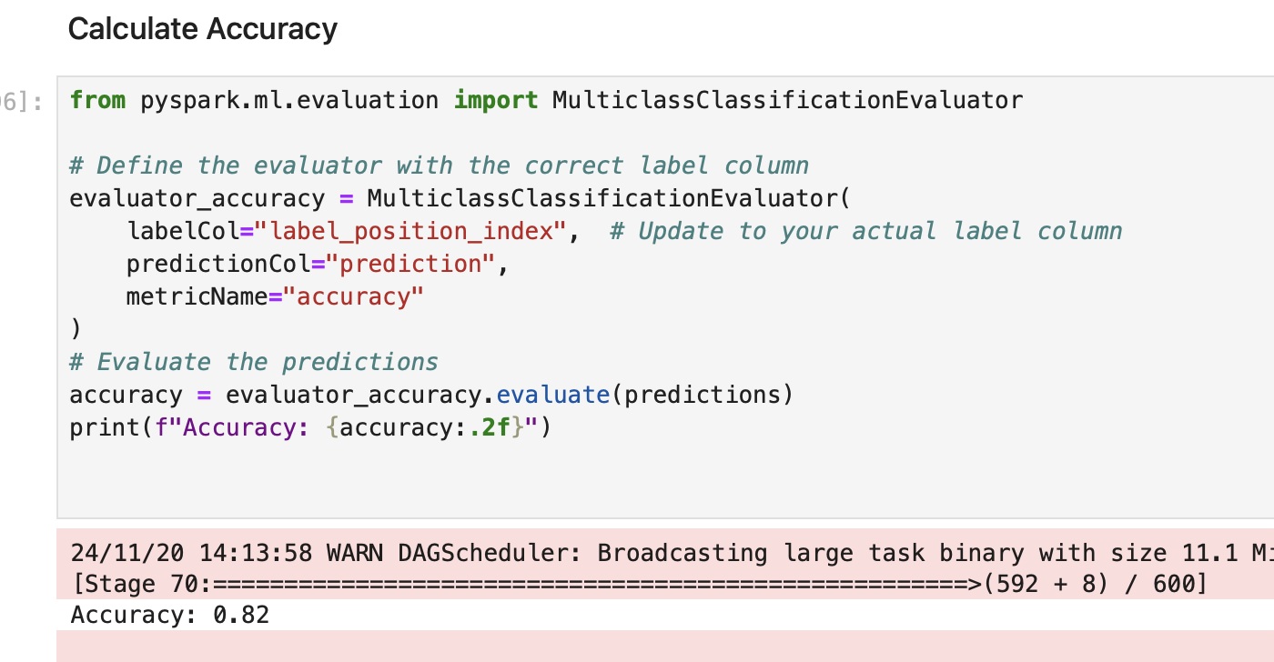
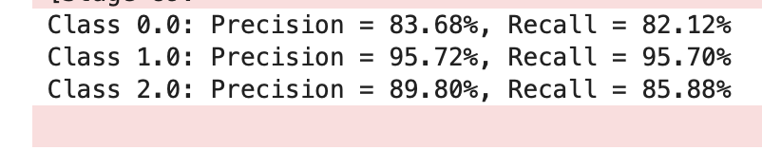
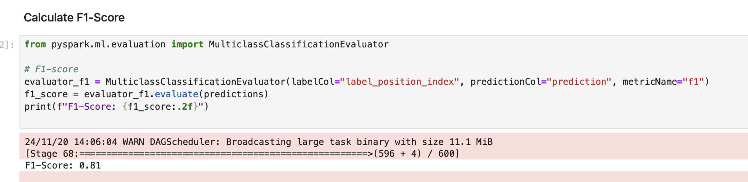
Model Development

Slide 21
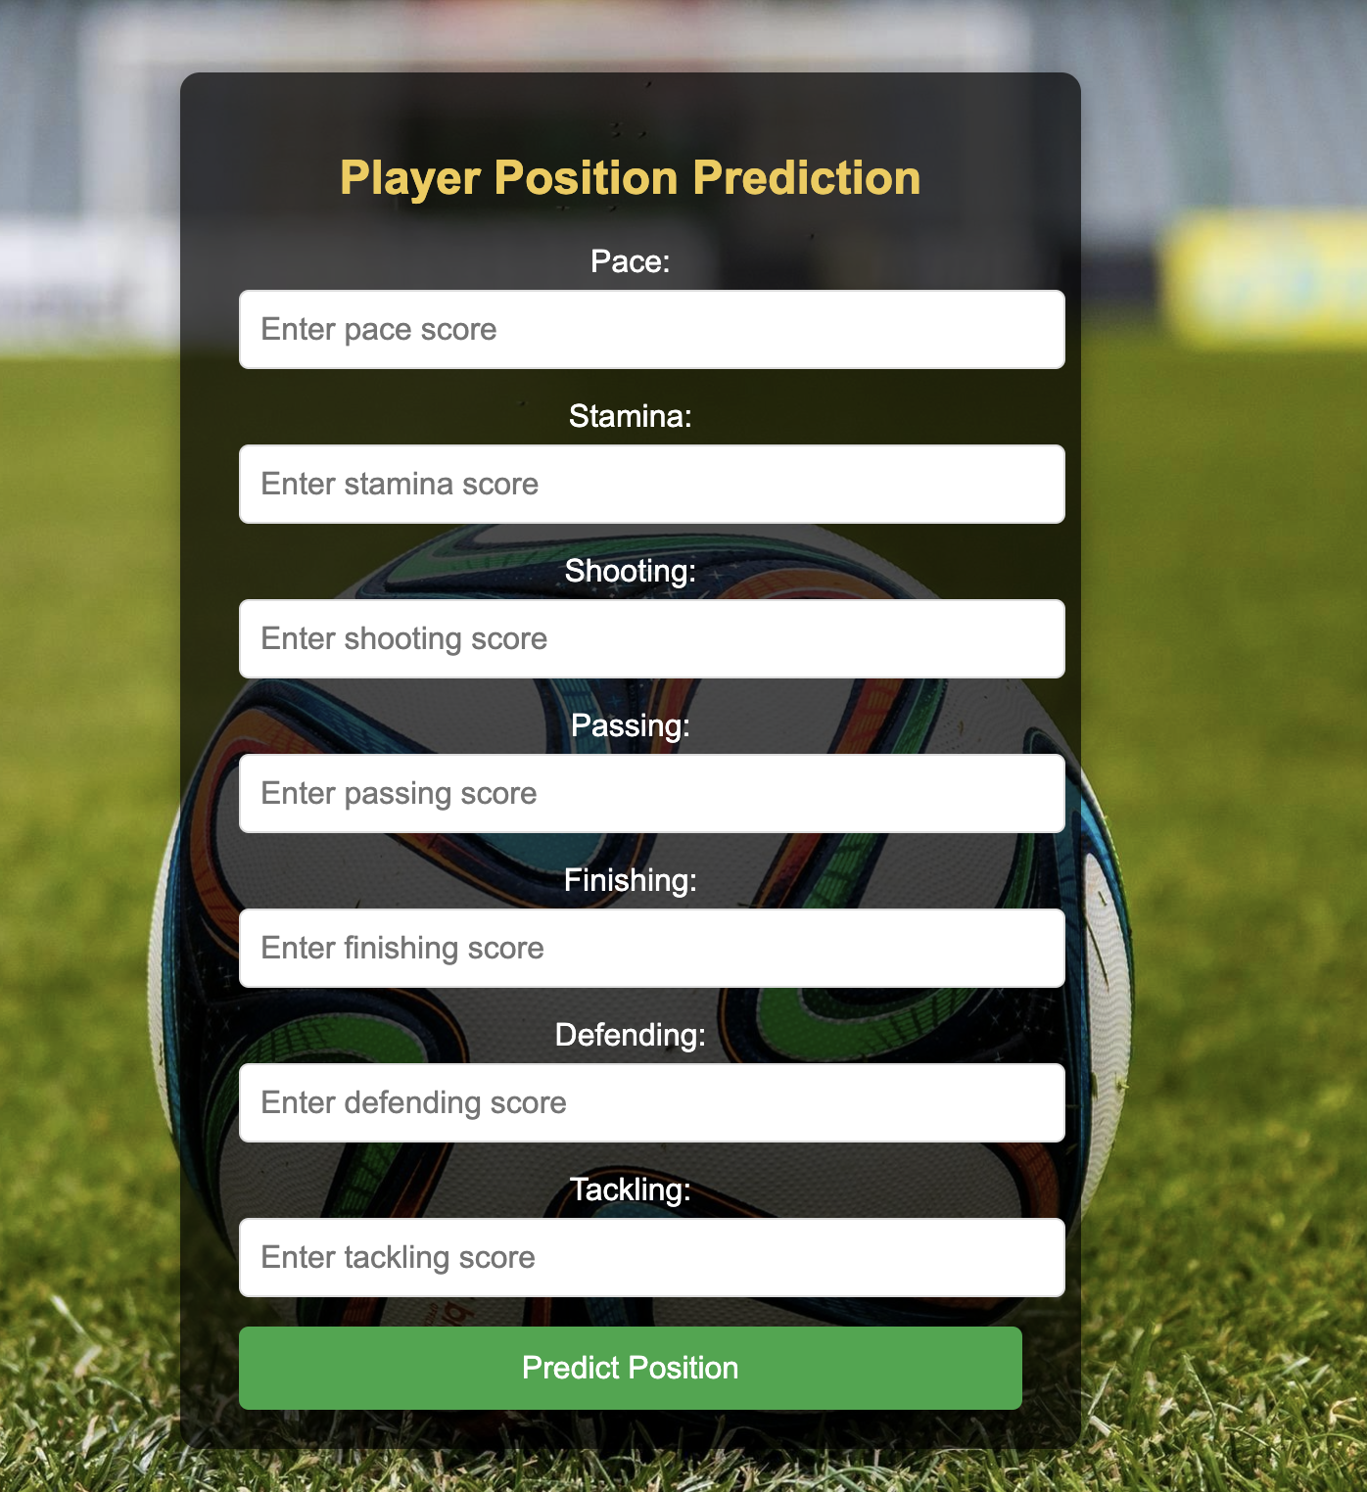
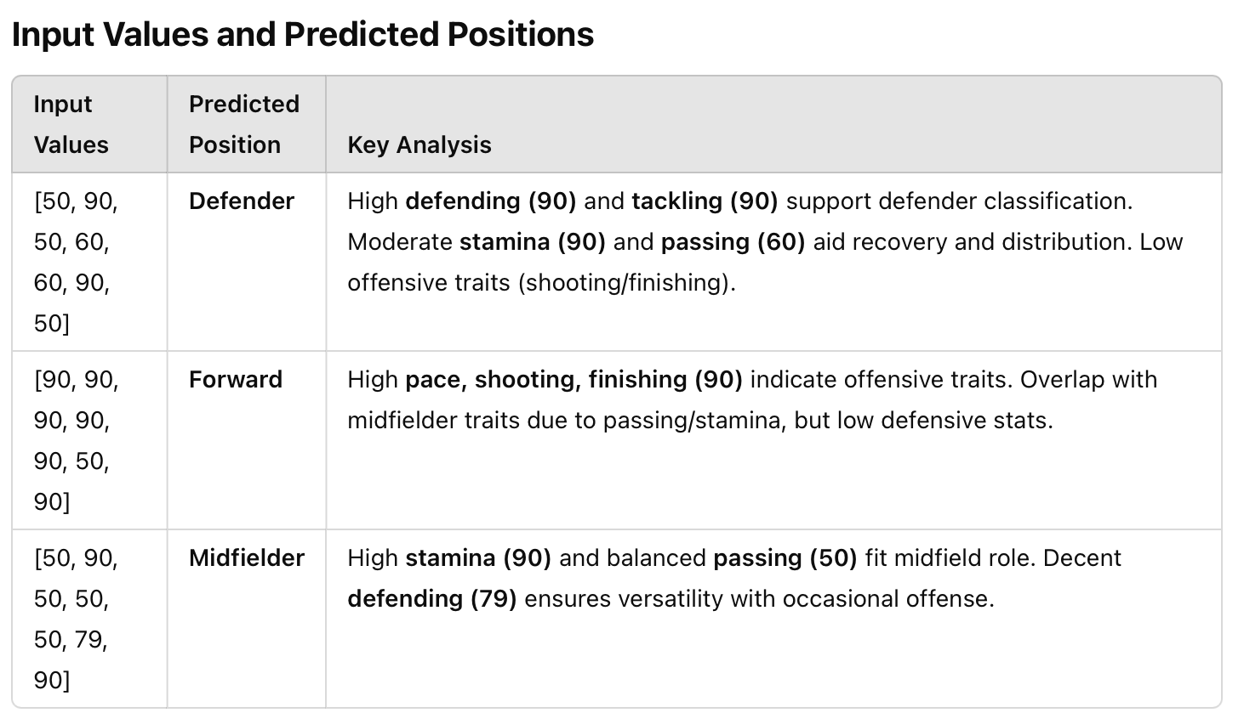
Demo-Players Position Prediction
User Benefits:
"This tool helps quickly analyze player capabilities based on their skill attributes."
”We can make more informed decisions for team formation and player recruitment."
Impact:
Automates position classification, saving time and effort.
Supports coaches and analysts in building balanced teams.
User-friendly interface makes advanced predictions accessible to non-technical users.
Notes:
Now, let’s look at our demo for player position prediction:
This tool helps analyze player capabilities based on their key skill attributes like pace, passing, and defending. It empowers coaches and analysts to make more informed decisions for team formation and player recruitment.
The model automates the process of classifying player positions, saving time and ensuring accuracy. Its user-friendly interface makes it accessible to both technical and non-technical users.
Through this demo, you’ll see how our model bridges data insights with real-world decision-making in soccer."

Slide 22
Conclusion
Achievements
Developed a robust machine learning model to predict soccer player positions (Defender, Midfielder, Forward) based on their skills and attributes.
Successfully implemented a Random Forest Classifier, achieving high performance in multi-class classification.
Addressed class imbalance using oversampling and undersampling, ensuring fair predictions across all classes.
Key Insights
Data-driven insights outperform subjective decision-making in player evaluation, increasing accuracy and efficiency.
A streamlined PySpark pipeline ensured scalability and efficient processing of large datasets like the 5.64 GB FIFA dataset.
21 selected features significantly influenced position predictions, demonstrating their relevance in player role identification.
Notes:
"In conclusion, our project successfully utilized machine learning to predict soccer player positions based on their attributes.
We achieved an 82% accuracy using the Random Forest Classifier and addressed class imbalance with effective oversampling and undersampling techniques. This ensured fair predictions for all roles, especially minority classes.
Our data-driven approach replaced subjective evaluations, offering objective and reliable insights for team formation and player development.
This project demonstrates how machine learning and big data can revolutionize decision-making in sports analytics."

Slide 23
Future Prospects
Expand the model to predict secondary positions or specialized roles for players.
Extend the methodology to other sports or industries requiring role optimization.
Integrate real-time data to support dynamic tactical adjustments during matches.
Notes:
"In the future, we aim to expand this project in several ways:
First, we plan to enhance the model to predict secondary or specialized player roles, providing more nuanced insights.
Second, integrating real-time data will allow coaches to make dynamic tactical decisions during matches.
Lastly, we see potential in applying this methodology to other sports or industries where role optimization is critical.
These steps will not only broaden the scope of our model but also increase its practical impact in diverse fields."

Slide 24
THANK YOU!

